Slide 1

The Role of Computer Graphics in Robotics

Slide 2
Dr. Md. Tauhid Bin Iqbal Assistant Professor Department of Computer Science and Engineering East West University
Presented To:
Presented By:
Jubaer Ahmed
2021-2-60-139
S M Nazmul Hasan
2021-2-60-040
Taslima Akter Sathi
2021-1-60-114
Md. Ripon Al Mamun
2021-2-60-083
1

Slide 3

Introduction
3D modeling and graphics are essential in modern robotics for visualizing, designing, and testing robotic systems before real-world production.
Through detailed 3D models, engineers can simulate movements, analyze structures, and optimize designs, leading to faster innovation and reduced costs.
Advanced platforms like Fusion 360, SolidWorks, and Sketchfab make it easier to create, simulate, and share robotics models with high precision and creativity.
2

Slide 4
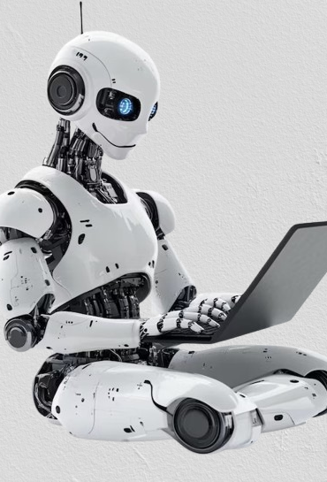



Applications of Computer Graphics in Robotics
Autodesk Fusion 360: Fusion 360 is a cloud-based platform for designing, simulating, and testing complete robotic systems in 3D.
SolidWorks: SolidWorks is a professional CAD tool used to create highly detailed and precise robotic parts with motion and stress simulation.
Sketchfab: Sketchfab is an online platform that allows users to explore, download, and share 3D robot models easily for visualization and prototyping.
3

Slide 5
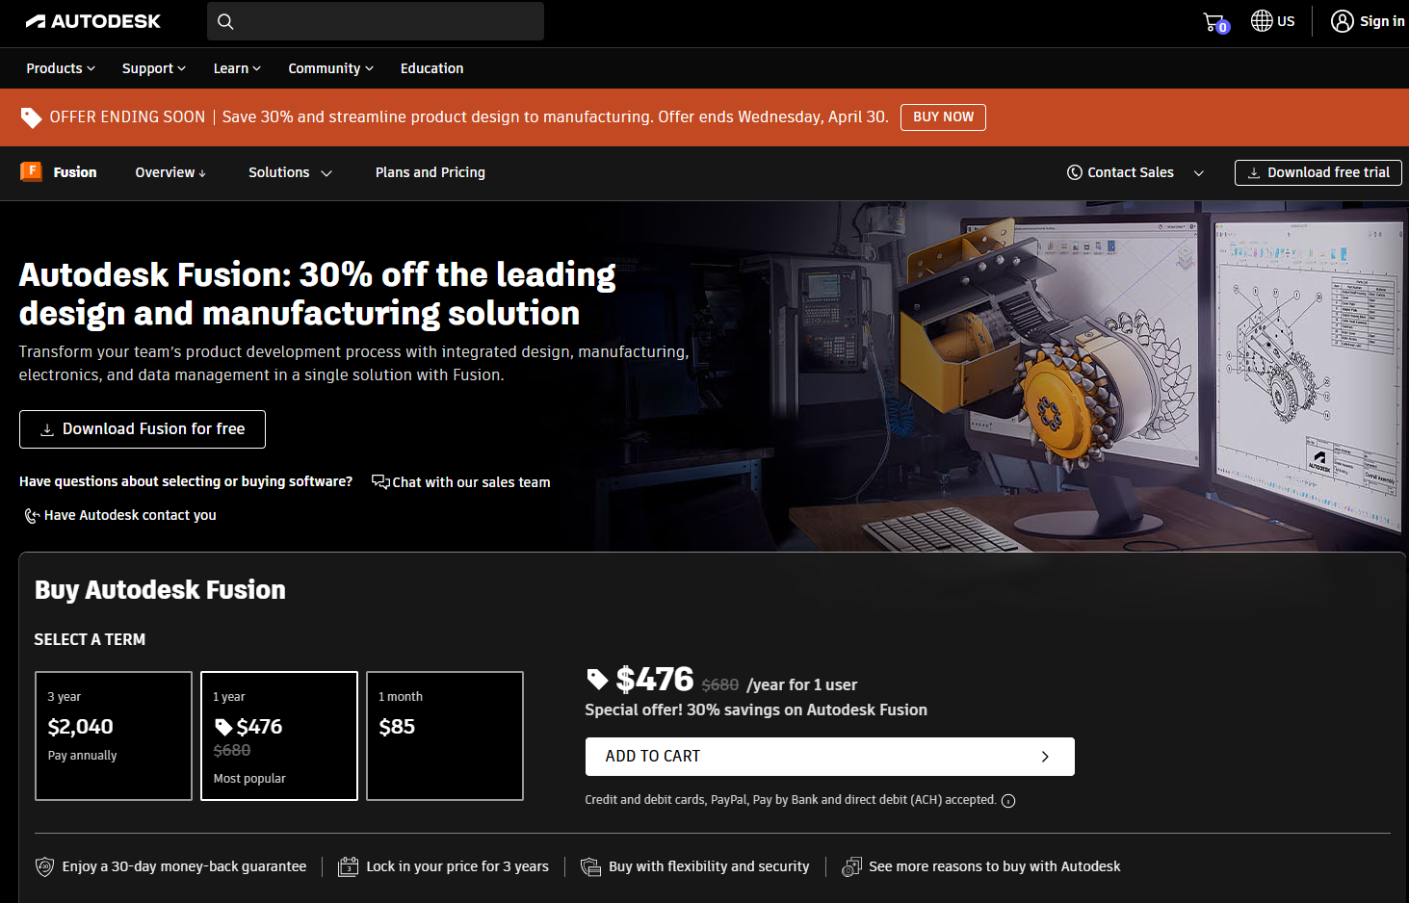
Autodesk Fusion 360
How it works
Fusion 360 is a cloud-based 3D CAD (Computer-Aided Design), CAM (Computer-Aided Manufacturing), and CAE (Computer-Aided Engineering) software.
Even though we install the software on our computer, all files are saved online (in the cloud).
We can do everything in one place designing (modeling), testing (simulation), and preparing for manufacturing (CAM).
4

Slide 6
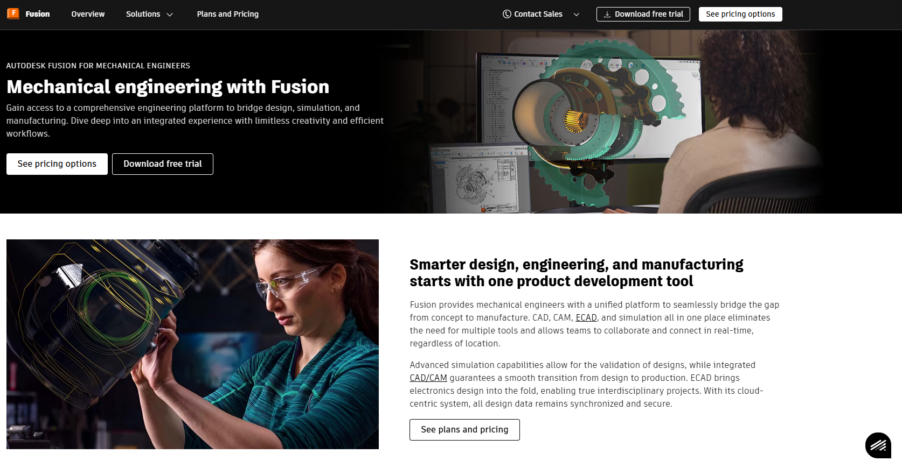
Autodesk Fusion 360
Functions of Fusion 360
Creates 3D Objects We can design things like robot arms, wheels, or complete robots.
Simulates Designs We can test if your robot parts will break or work properly virtually, before making them.
Designs Electronics We can even design circuit boards for robots inside Fusion 360.
Collaborates Multiple people can work together on the same project online.
5

Slide 7

SolidWorks
How it works
SolidWorks is professional CAD software.
It runs mainly on our computer (it is not cloud-based).
It is used to create strong 3D models and run motion simulations.
6

Slide 8
SolidWorks
Functions of SolidWorks
Parts & Assembly Design We can design small parts like pistons or gears, and then assemble them to make a full robot.
Motion Study We can study how our robot moves like how the wheels turn or how the arms lift.
Stress Analysis We can test where parts might break or where more pressure will happen.
Drawing Creation It can also create professional 2D drawings (blueprints) for building the robot.
7

Slide 9
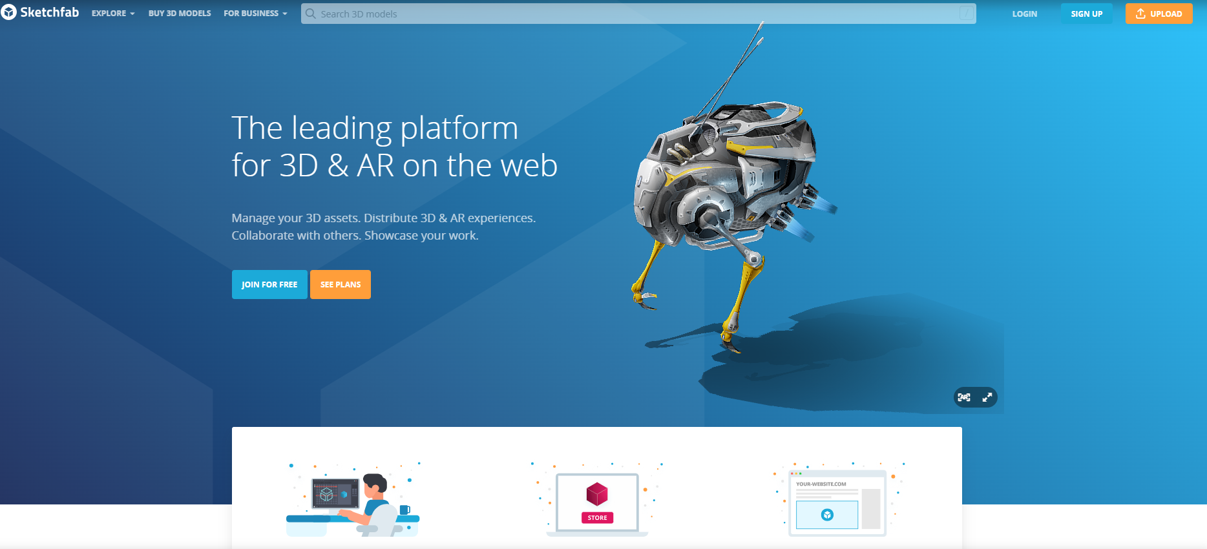
Sketchfab
How it works
Sketchfab is an online platform for 3D models.
We use it directly from a website.
We can explore, download, and even upload 3D robot models.
8

Slide 10
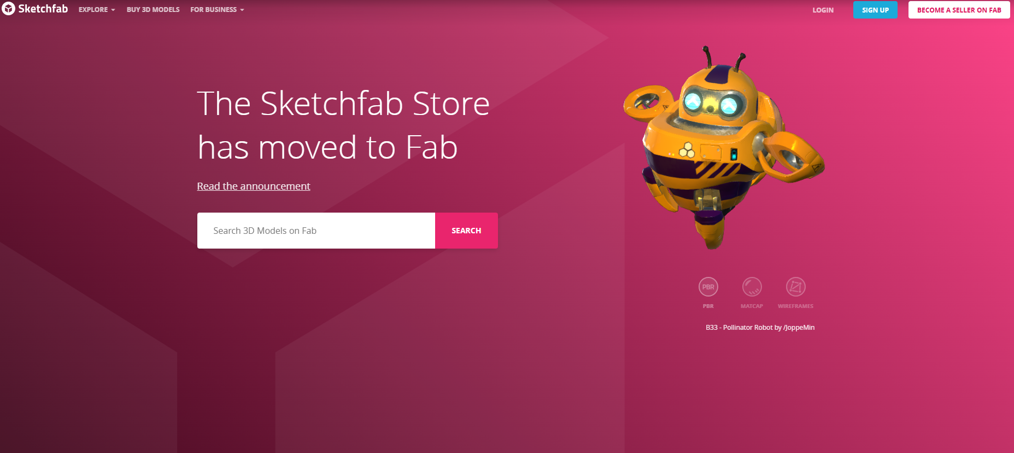
Sketchfab
Functions of Sketchfab
Provides Ready-made Models We can find lots of ready 3D robot parts like wheels, sensors, and robot arms no need to make them from scratch.
3D Viewer We can view 3D models directly on our mobile or computer without installing anything.
Marketplace We can sell your own 3D models if we want.
AR/VR Ready We can view models in Augmented Reality (AR) or Virtual Reality (VR) devices for a real-world experience.
9

Slide 11
Conclusion
3D graphics play a vital role in modern robotics by making design, testing, and visualization easier and more accurate.
Autodesk Fusion 360 helps engineers create and simulate complete robotic systems with cloud collaboration.
SolidWorks provides powerful tools for building highly detailed robotic parts and studying their real-world motion and stress.
Sketchfab allows users to access, share, and explore a wide variety of ready-made 3D robot models quickly and interactively.
Together, these platforms make robotics development faster, smarter, and more creative.
10

Slide 12
THANK YOU

